Slide 1


Customer Behavior Analysis
Data-Driven E-commerce Strategy Insights
PYTHON
POSTGRESQL
DATA VISUALIZATION

Slide 2

Business Problems
Core Challenges
68% male customers, untapped female market potential
Subscription rate only 27%, large room for customer lifetime value improvement
Rating 3.75/5, satisfaction needs improvement
Need to identify high-value customer groups and formulate retention strategies
Analysis Goal: Uncover growth opportunities and optimize marketing strategies using 3,900 transaction data points.

Slide 3
Dataset Overview
3,900
18
0.95%
0
Transaction Records
Data Fields
Missing Values
Duplicate Records
Complete customer transaction data
Key variables after cleaning
Only 37 rating entries missing
Excellent data quality
Data Source: E-commerce Transaction Database | Key Fields: Customer ID, Age, Gender, Category, Purchase Amount, Rating, Subscription Status, Discount Usage, Purchase Frequency

Slide 4
Core Business Questions and KPIs
Key Questions
Core Metrics
Demographic characteristics of customer groups?
Which product categories drive revenue?
Differences in purchasing behavior across age groups?
Relationship between purchase frequency and satisfaction?
How effective are discount promotions?
Average Transaction Value: $59.76
Total Revenue: $233,081
Average Age: 44.1 years
Average Rating: 3.75/5.0
Subscription Rate: 27%
Discount Usage Rate: 43%

Slide 5
Data Cleaning and Preparation
01
02
Handling Missing Values
Duplicate Check
37 missing ratings (0.95%), filled with category mean to maintain distribution
No duplicate records found, all 3,900 entries are unique transactions
03
04
Data Transformation
Hypothesis Verification
Created age groups (4 intervals), numericalized purchase frequency, standardized categorical variables
Each row represents a unique transaction, ratings are randomly missing, amounts are accurately recorded

Slide 6

Exploratory Data Analysis
Demographics
Purchase Behavior
Customer Satisfaction
Age distribution is even (18-70 years old), males account for 68%, and each of the four age groups accounts for approximately 25%.
Spending amount is evenly distributed ($20-$100), clothing and accessories dominate, while footwear and outerwear have a smaller proportion.
Ratings are concentrated between 3.0-4.5, with an average of 3.75, and age, amount, and rating have a weak correlation (<0.05).
Seasonal Patterns
Sales are evenly distributed across all four seasons, with no seasonal dependence, indicating stable year-round demand.

Slide 7
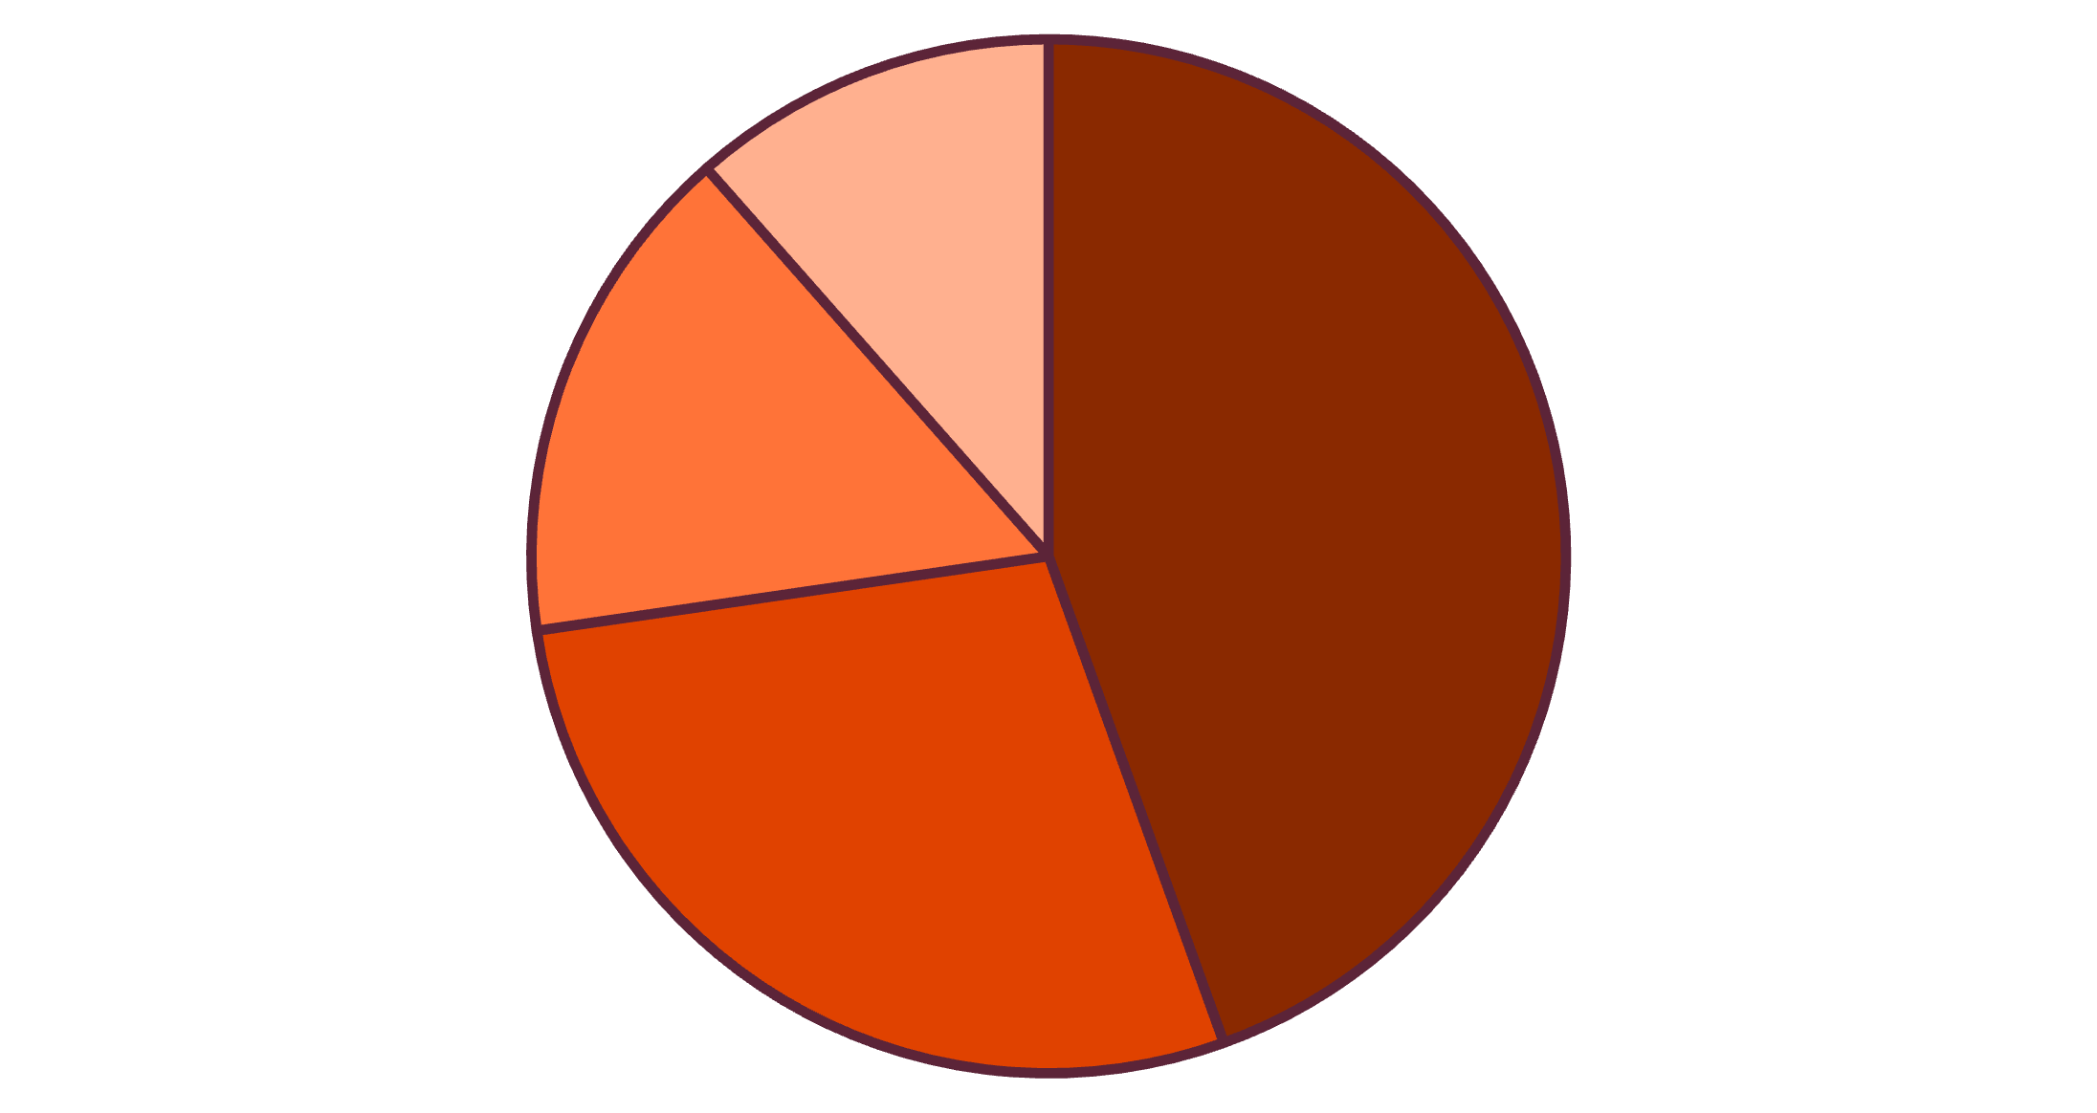
Deep Insights
Key Findings
Apparel Dominance: 44.5% of sales from apparel category
High Repurchase Rate: Average 25.4 historical purchases, strong loyalty
Gender Imbalance: 68% male customers, untapped female market
Effective Discounts: 43% usage rate proves successful promotional strategy
Subscription Potential: Only 27% subscription rate, large conversion opportunity
Apparel
Accessories
Footwear
Outerwear

Slide 8


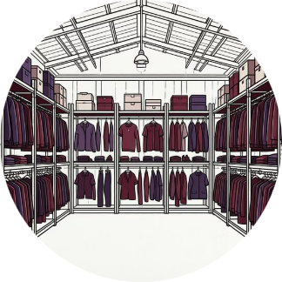
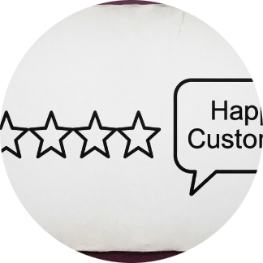


Data-Driven Business Recommendations
Expand Female Customer Base
Increase Subscription Rate
Optimize Inventory Allocation
Improve Customer Satisfaction
Offer 15-20% annual subscription discount, aiming to increase from 27% to 40%+.
Launch marketing campaigns targeting women, expecting 10-15% customer growth within 6 months.
Allocate 60-70% of budget to apparel and accessories, reduce slow-moving categories.
Implement quality assurance program, aiming to raise rating from 3.75 to 4.2+.
Optimize Discount Strategy
Age-Targeted Marketing
Tailor messages for four age groups, enhancing conversion rates and satisfaction.
Test tiered discount structures, maintain conversion rates while increasing profit margins by 5-10%.

Slide 9
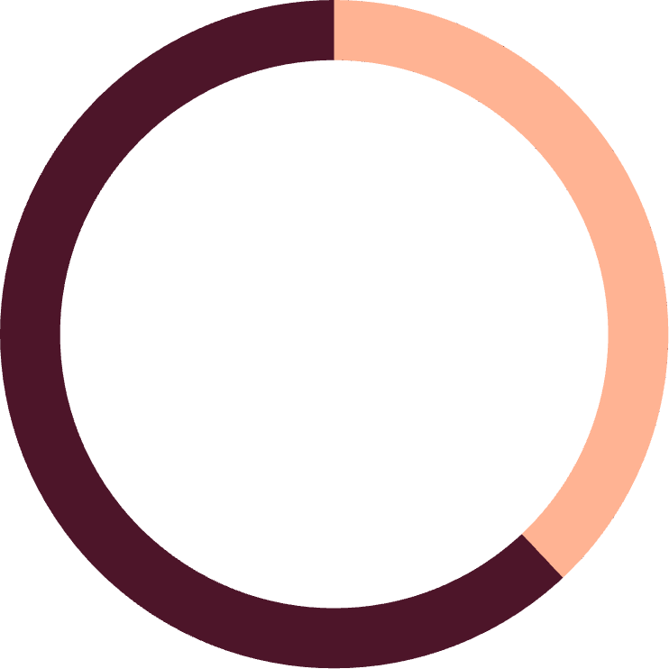

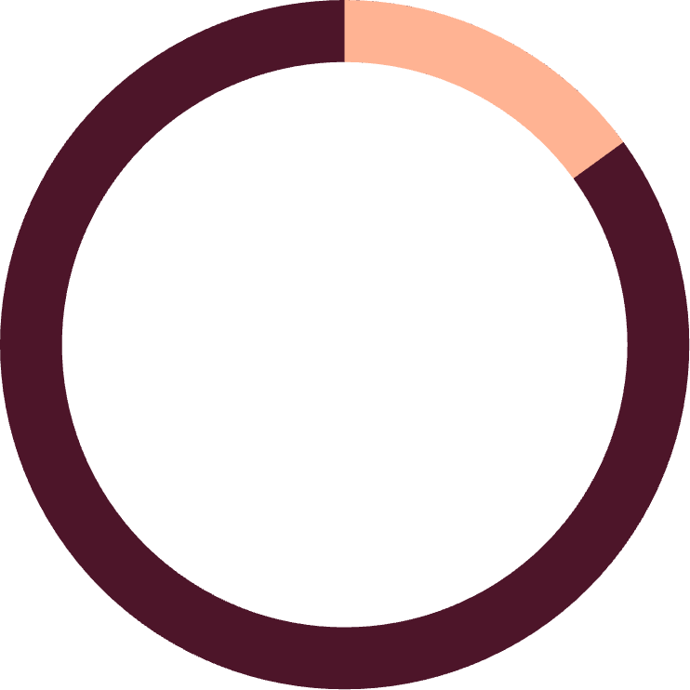
Expected Business Impact & Conclusion
38-58%
40%
15%
Revenue Growth Potential
Subscription Rate Target
Customer Base Growth
Annual increase $88K-$135K
Increase from 27% to 40%+
3,900→4,500 customers
Key Conclusion: Analysis reveals a stable and profitable business with significant growth potential. By expanding the female market, increasing subscription rates, and improving satisfaction, a 38-58% revenue growth can be achieved. It is recommended to immediately launch female marketing campaigns and subscription incentive programs, implement quality improvements within 3-6 months, and complete inventory optimization within 12 months.
Confidence Level: High — Based on clear customer behavior patterns and e-commerce industry best practices

